Slide 1


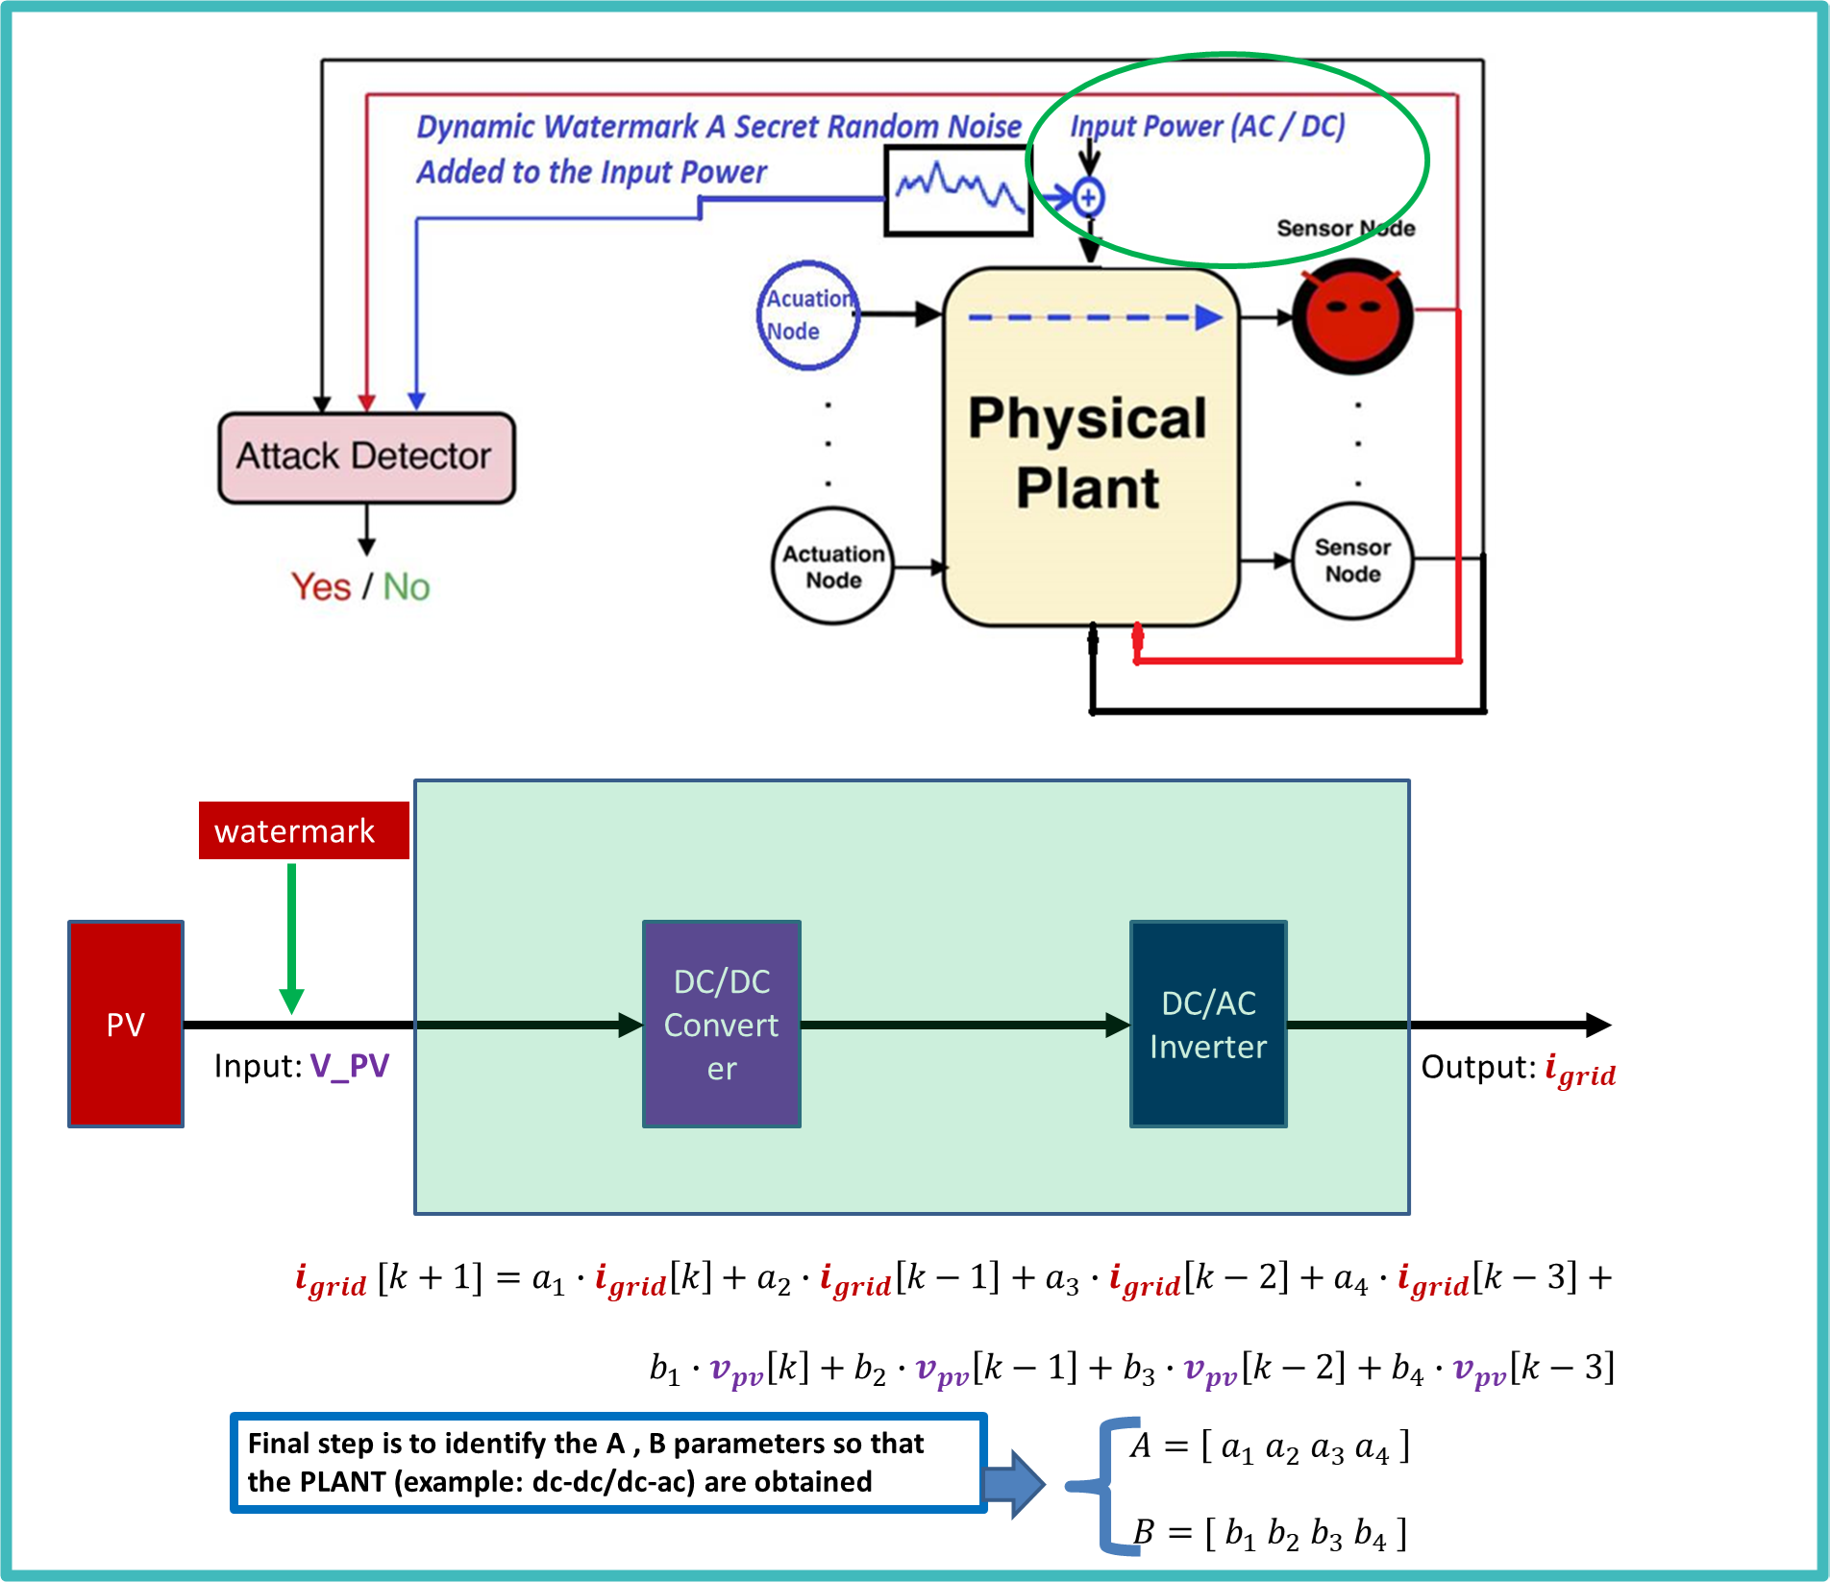
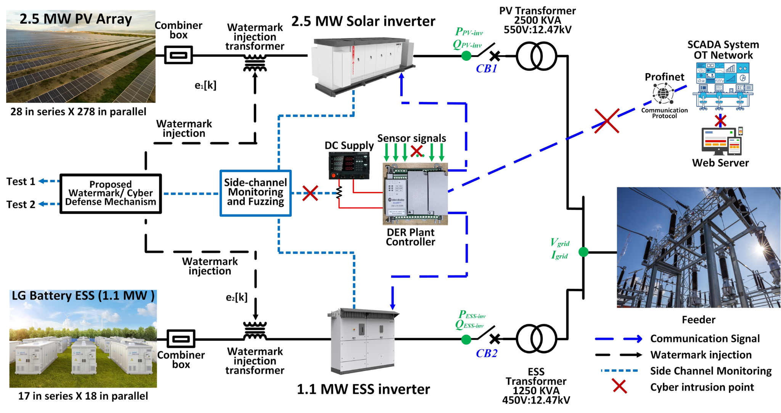
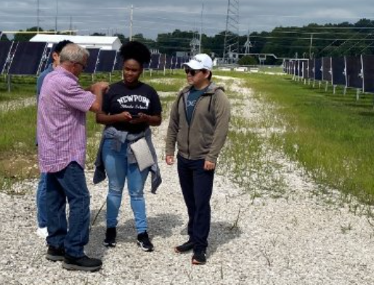
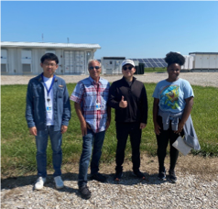
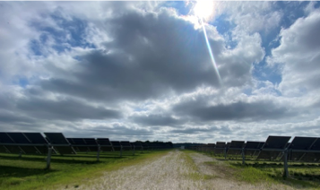
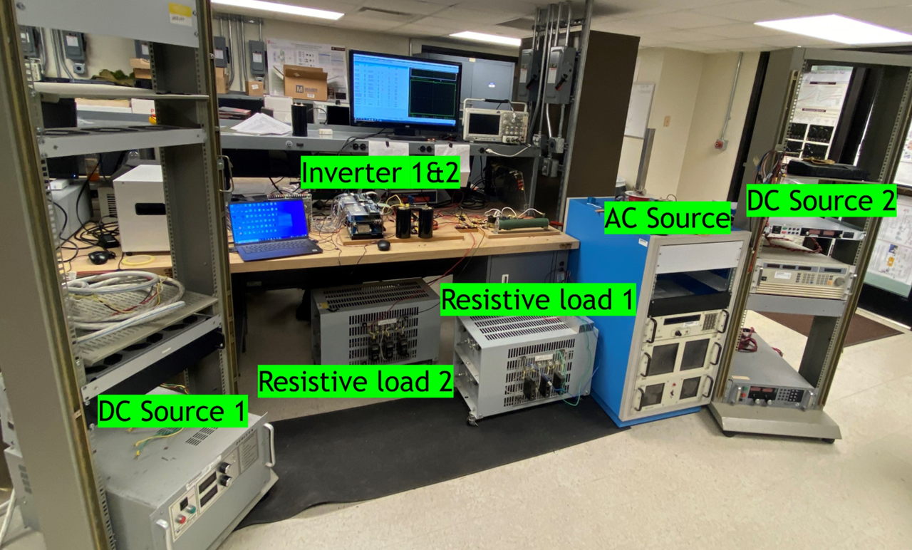
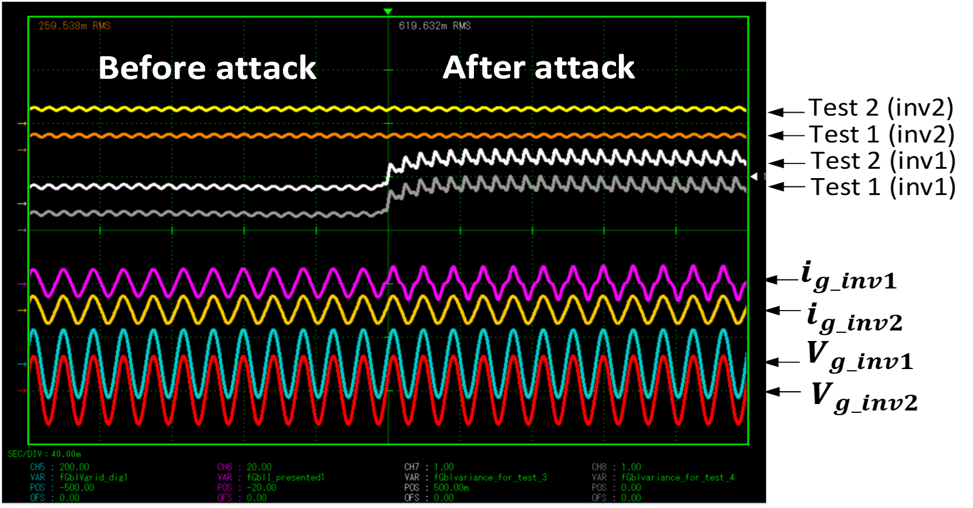
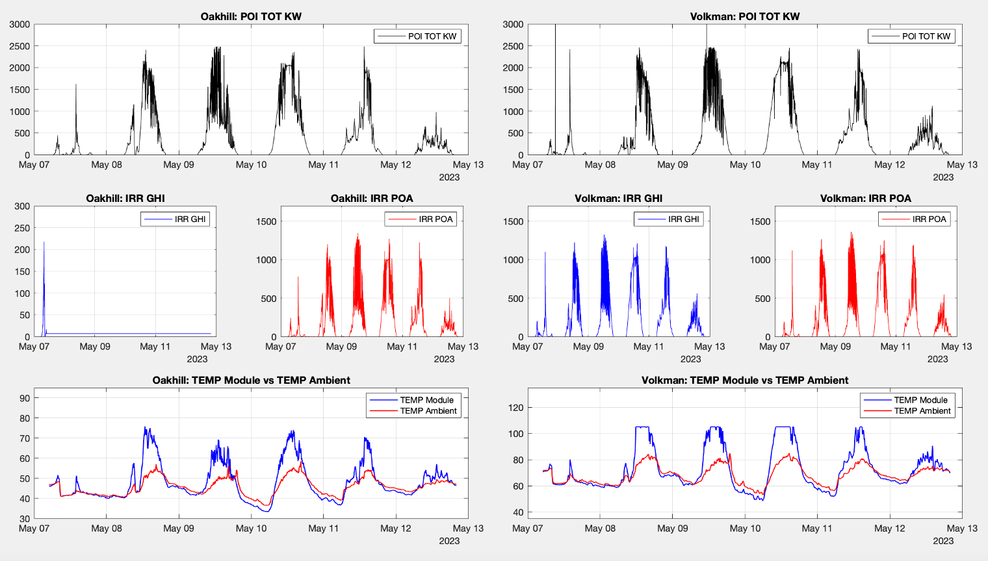
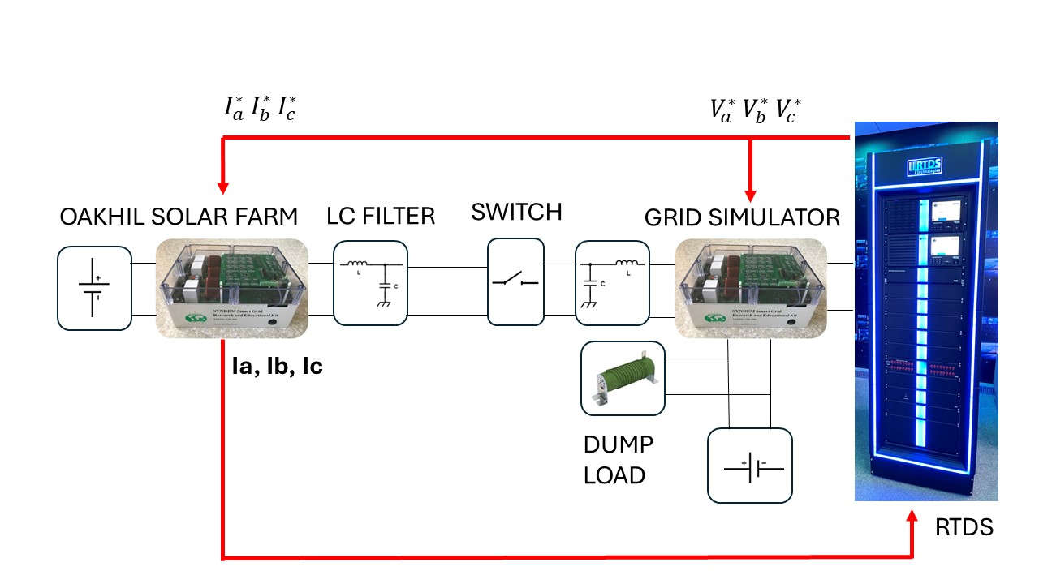




Secure Monitoring and Control of Solar Power Distribution System through Dynamic Watermarking
Non-Cognitive Predictors of Student Success: A Predictive Validity Comparison Between Domestic and International Students
PROJECT NAME: Secure Monitoring and Control of Solar Power Distribution System through Dynamic Watermarking
Lead Organization: Texas A&M University
Contact: le.xie@tamu.edu (Dr. Le Xie)
Cybersecurity for Operational Technologies and the Smart Grid
Sponsor:
BACKGROUND and OVERVIEW
Non-Cognitive Predictors of Student Success: A Predictive Validity Comparison Between Domestic and International Students
PV-dominant distribution grids are Cyber-Physical Systems (CPS).
Attacker can compromise the system by manipulating devices at the grid edges.
How to defend PV-dominant distribution grids against potential cyber-attacks?
METHODS
The core idea of the proposed approach - Dynamic Watermarking (DW) is to introduce a private (secret) random watermarking signal into the control inputs of the DC-DC converter and DC-AC inverter stages.
Dynamic Watermarking (DW) can detect Record & Replay Attack, which is a sophisticated attack and hard to detect. Upon gaining access an attacker can record the sensor signals, disconnect the sensor & reply the recorded signal back to the controller.
Prototype DC-AC Inverter output current sensor Replay attack:
Attacker stores the measurements obtained from the system at some time in the past, and plays them back as current measurement
Since the watermark is an arbitrary signal, the current measurement will have a different watermark signature and the variance tests will detect the difference
KEY MILESTONES
The Dynamic Watermarking (DW) algorithm can reach 95% attack detection accuracy in the computation platform.
The resilient control scheme can stabilize the distribution system within 10 min in the computation platform.
Data required for testbed configuration is provided by CenterPoint Energy (real-world testbed).
CONCLUSION
Other Contributors/Partners:
The proposed end-to-end cyber-secure and resilient monitoring and control framework using Dynamic Watermarking (DW) is an add-on option, does not require any modification to the existing PV/Battery grid connection / existing controls.
Dynamic Watermarking (DW) methodology is a general-purpose pro-active defense method for detecting potential cyber-attacks and any malicious activities in the system.
Massachusetts Institute of Technology
Illinois Institute of Technology
Argonne National Laboratory
CenterPoint Energy
Notes:
Notes:
In Powerpoint, click View > Guides
Keep text within gutter guides.
Author list: Don’t split names onto two lines (e.g., “Jimmy [break] Smith”). If that happens, use a new line, unless you need the space. Bold the first names of anybody who’s presenting in person.
Intro/methods/result: Do not drop below font size 28, but if you have extra space, jack up the font size until the space is full.
Do not use color in the sidebars except in graphs/figures. It’ll pull attention from the center and slow interpretation for passersby.

